Slide 1
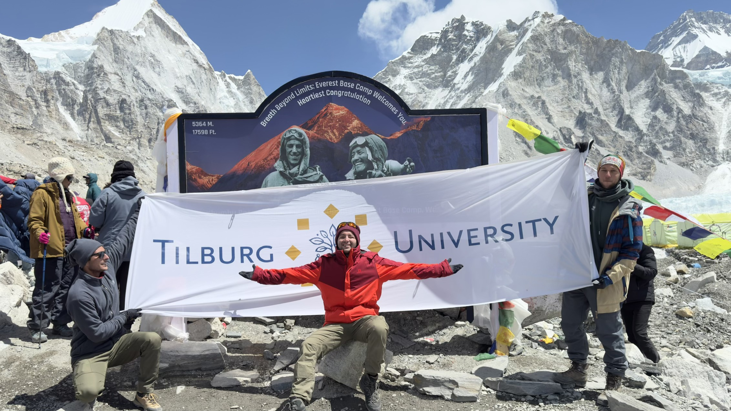
WHY ROOKIES
We started by raising the TiU flag at 5,700 meters. Now we want to do the same for the students who carry it next — at every step they take.
With the data, the guidance, and the platform every transition deserves.
EVEREST BASE CAMP · 5,700M · 9 APRIL 2024
ROOKIES — PARTNERSHIP PROPOSAL
01 / —

